Slide 1
Concur Travel and Expense Management
Travel Request

Slide 2
Navigate to Concur at Concur.Jefferson.Edu, from anywhere
Sign on using your campus key and password

Slide 3
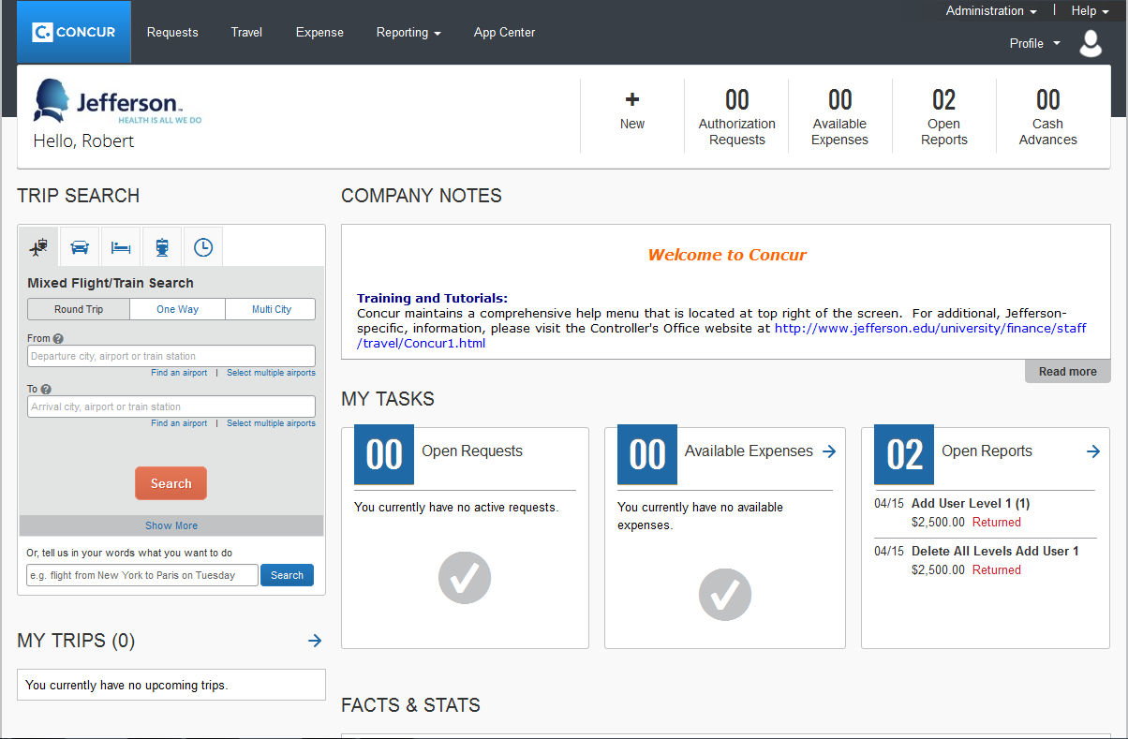
Click on Request

Slide 4
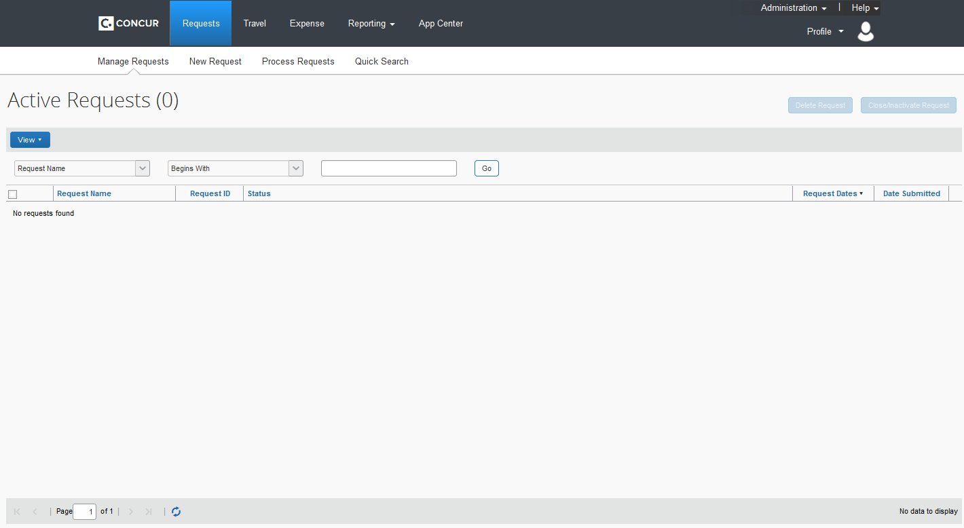
Click on New Request
Travel Request are Required when one or more of these three reasons are met:
International Travel
Corporate Ghost Card Request
Cash Advance Request

Slide 5
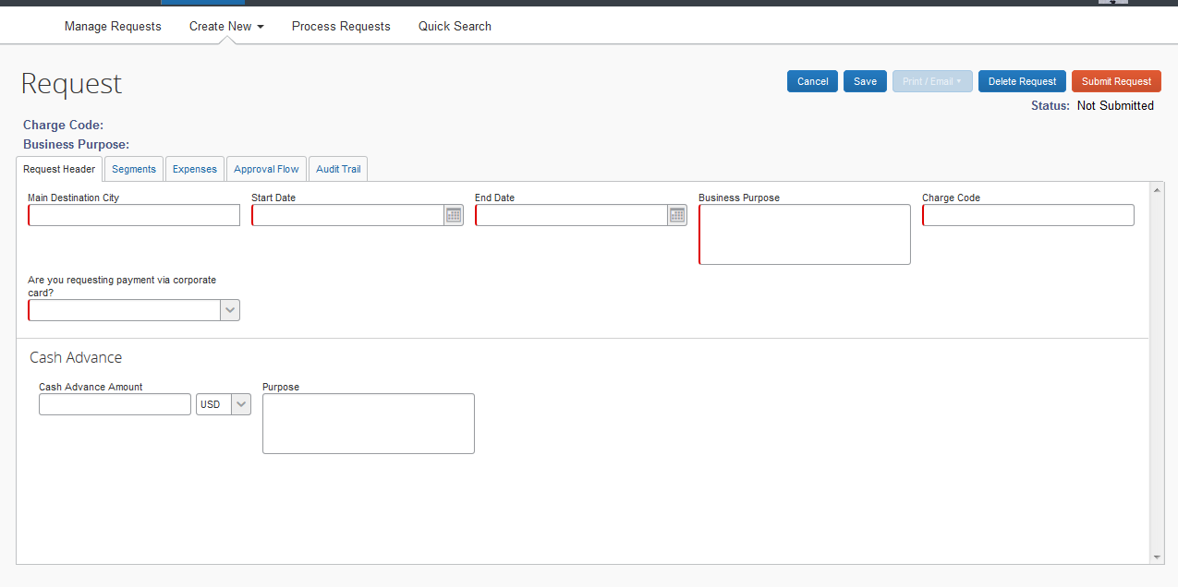
Enter information in each of the required fields (indicated by the red highlighted left border).
Verify if you are requesting use of our Corporate Ghost Card (Use the drop down to select either yes or no).
If you require a Cash Advance, you must enter that information directly on the Request.
Click Segments>>

Slide 6
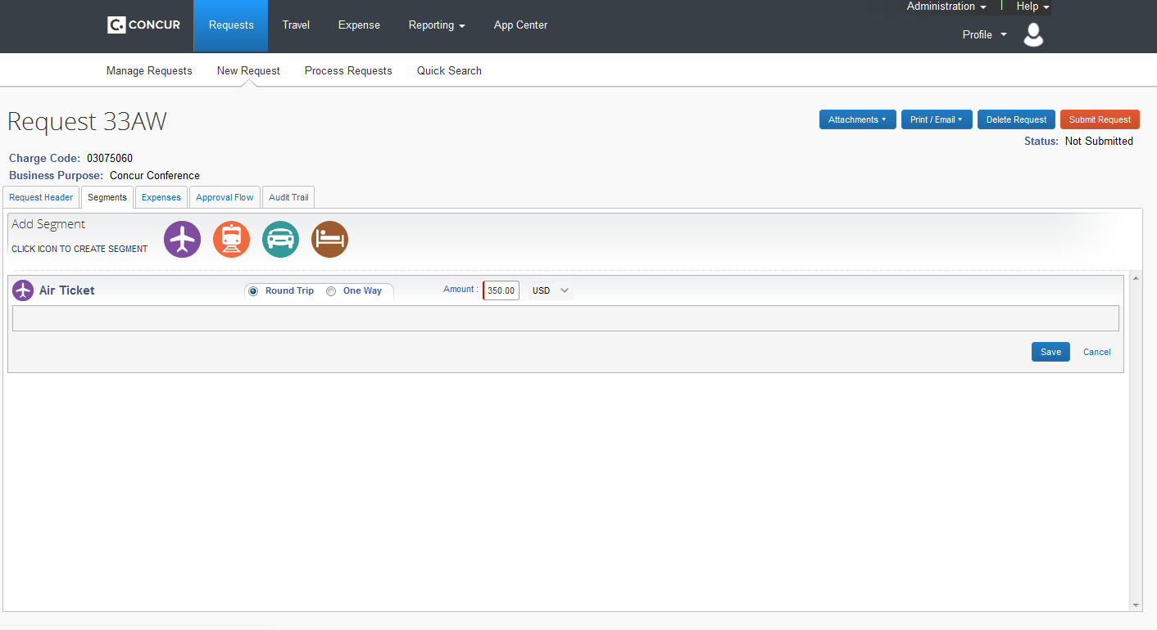
Select the appropiate segments, such as Air, Train, Car Rental and/or Hotel, that are being requested.
After selecting a segment, you will be prompted to enter the estimated amount. Then select Save.
Click Expenses >>

Slide 7
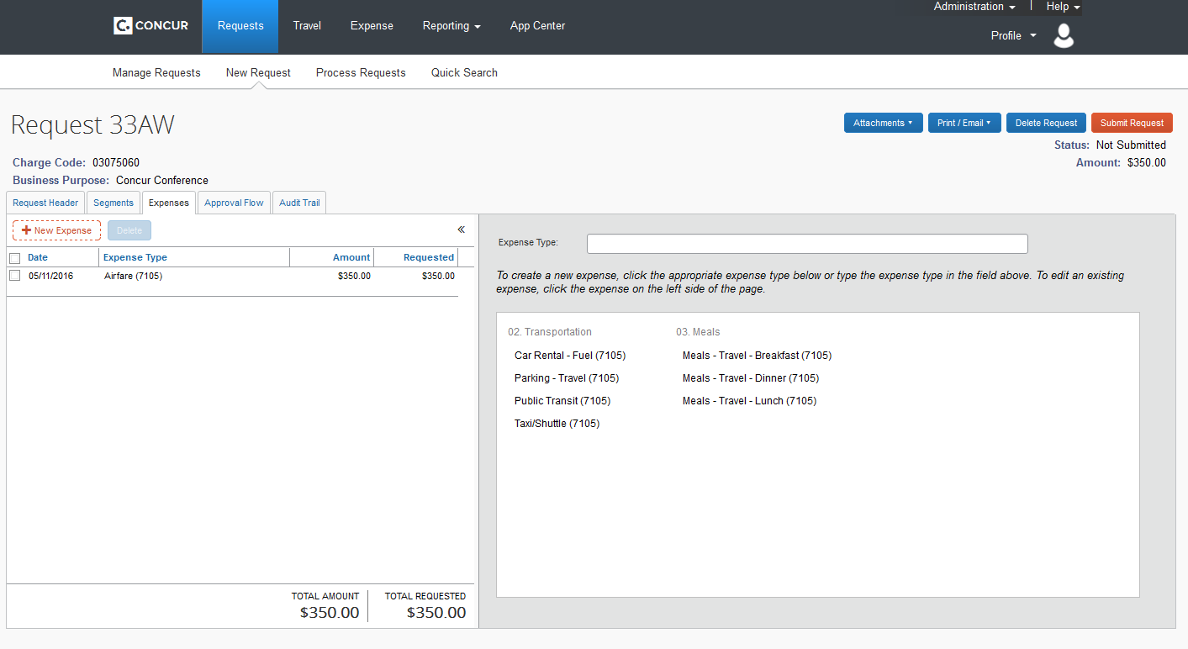
In this tab, you can request other expenses that may require a Travel Request.
Click Approval Flow >>

Slide 8
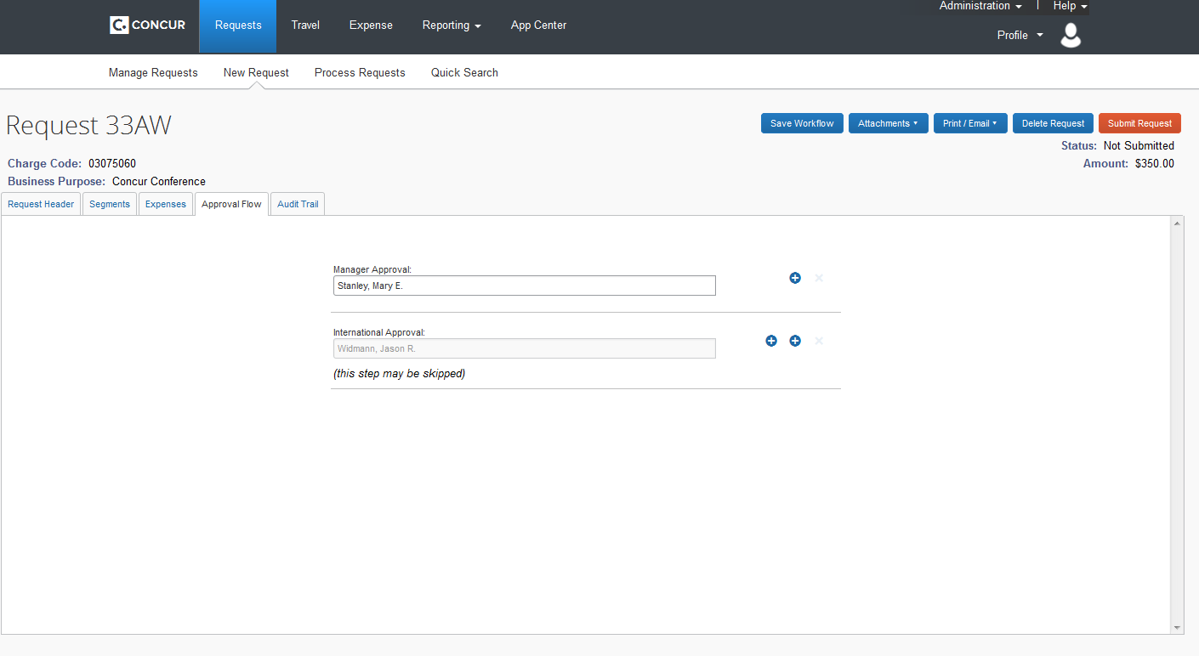
In this tab, you can view your Approval Flow process . Also, this is the only area to change Approval Flow, if another approver is required.
Click Audit Trail >>

Slide 9
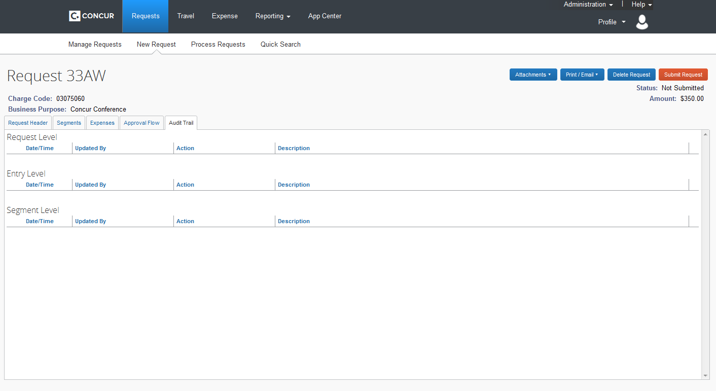
In this tab, you can view any actions that have been conducted within the report.
Please attached appropiate documentation, if required, to speed the process along. Use the Attachments drop down, select Attach Documents.
When completed, select Submit Report.

Slide 10
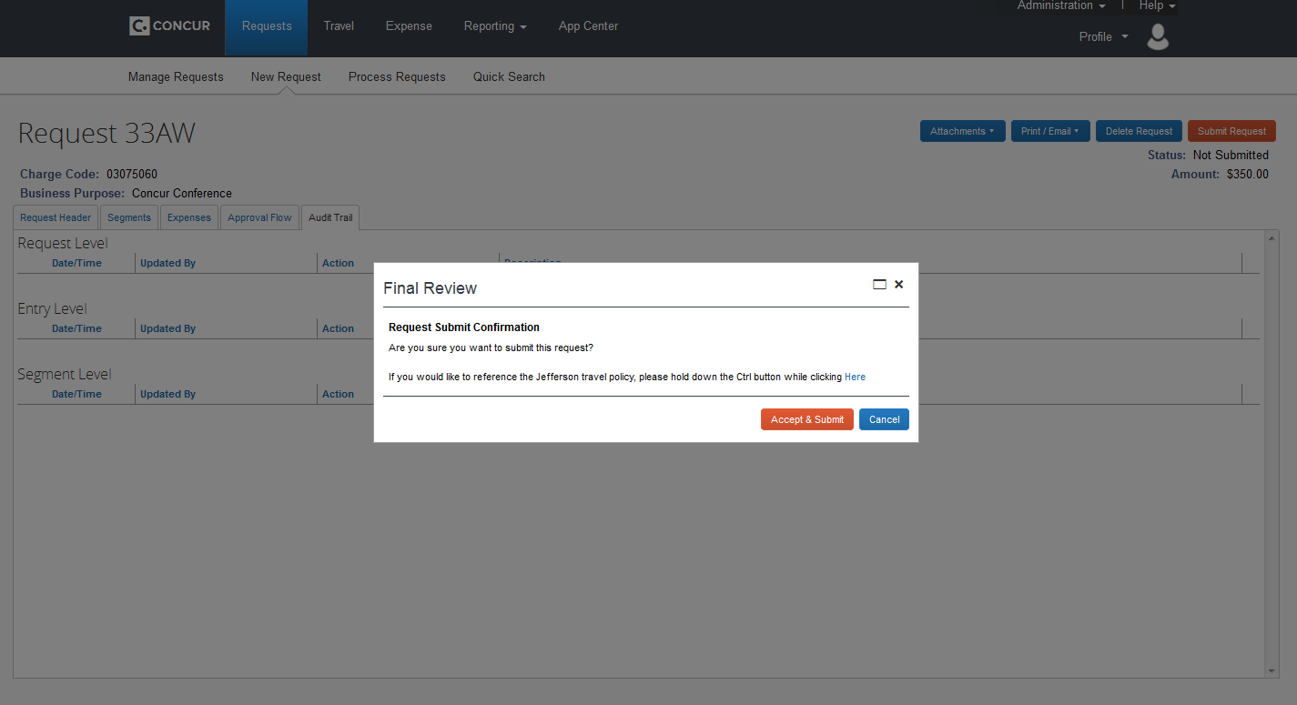
Select Accept & Submit

